Slide 1


Power BI Desktop Heart Disease Diagnostic Analysis
This comprehensive Power BI report provides deep insights into heart disease diagnosis, enabling healthcare professionals to make informed decisions and improve patient outcomes. The interactive visualizations and data-driven analysis empower users to uncover patterns, identify risk factors, and develop targeted interventions.

Slide 2

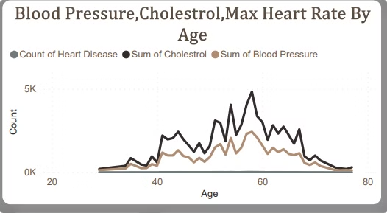
Cholesterol, Blood Pressure, Max Heart Rate By Age
Monitoring cholesterol levels is crucial for heart health. Effective management of blood pressure can reduce heart disease risk. Understanding max heart rate is essential for assessing cardiovascular health. This section provides insights into how these key metrics change with age, enabling more targeted interventions and preventive measures.

Slide 3

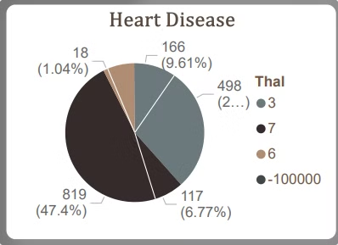
Thalassemia and Heart Disease
The report explores the relationship between thalassemia, a genetic blood disorder, and the development of heart disease. Understanding the interplay between these two conditions is crucial for healthcare providers to develop comprehensive treatment plans that address the unique needs of patients with both thalassemia and cardiovascular complications.
1
Thalassemia Impact
Thalassemia can have a significant impact on cardiovascular health, increasing the risk of heart disease and related complications.
2
Comprehensive Care
Patients with thalassemia require specialized care that addresses both the hematological and cardiovascular aspects of their condition, ensuring optimal health outcomes.
3
Personalized Approach
A personalized, multidisciplinary approach is essential for managing the complex interactions between thalassemia and heart disease.

Slide 4

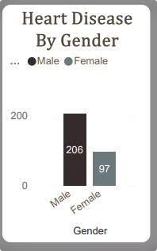
Heart Disease by Gender
The report examines the prevalence of heart disease across genders, revealing significant differences in the distribution and severity of the condition. This information is crucial for tailoring prevention and treatment strategies to address the unique needs of male and female patients.
1
Male
Heart disease is more common and often more severe in male patients, requiring specialized care and targeted interventions.
2
Female
While less prevalent, heart disease in female patients can present unique challenges and requires a nuanced approach to diagnosis and management.

Slide 5
Heart Disease Gender Chest Pain By Gender
Chest pain can be categorized into several types, including asymptomatic, non-anginal, atypical angina, and typical angina. Understanding these categories helps in diagnosing heart disease effectively. The analysis shows the distribution of heart disease across genders, highlighting the differences in how males and females experience chest pain. The count of heart disease cases is crucial for understanding the prevalence of the condition among different demographics.
Chest Pain Experienced
Gender Distribution
Heart Disease Count
Chest pain can be categorized into several types, including asymptomatic, non-anginal, atypical angina, and typical angina. Understanding these categories helps in diagnosing heart disease effectively.
The analysis shows the distribution of heart disease across genders, highlighting the differences in how males and females experience chest pain.
Count of heart disease cases is crucial for understanding the prevalence of the condition among different demographics.

Slide 6

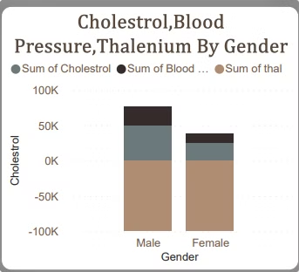


Blood Pressure by Gender
The report examines the distribution of blood pressure levels across genders, providing valuable insights into the unique cardiovascular health profiles of male and female patients. Understanding these differences is crucial for developing tailored prevention and treatment strategies that address the specific needs of each population.
Male
Male patients tend to have higher blood pressure levels, increasing their risk of heart disease and related complications.
Female
Female patients generally have lower blood pressure levels, but may still be at risk for hypertension-related health issues.

Slide 7
Restecg By Gender
Resting electrocardiogram (Restecg) results can indicate the presence of heart disease and vary by gender. Restecg is a vital diagnostic tool that helps in assessing heart conditions and guiding treatment options. Understanding how Restecg results differ between genders can lead to more tailored and effective treatment plans.
1
Electrocardiogram Results
2
Importance of Restecg
3
Gender Differences
Restecg is a vital diagnostic tool that helps in assessing heart conditions and guiding treatment options.
Understanding how Restecg results differ between genders can lead to more tailored and effective treatment plans.
Resting electrocardiogram (Restecg) results can indicate the presence of heart disease and vary by gender.

Slide 8

Cholesterol Levels by Age
The report examines the relationship between age and cholesterol levels, a key risk factor for heart disease. By understanding the typical cholesterol profile across different age groups, healthcare providers can better identify and manage individuals at high risk, implementing targeted interventions to maintain optimal cardiovascular health.
1
Younger Patients
Younger patients tend to have lower cholesterol levels, but may still be at risk for heart disease due to other factors.
2
Middle-Aged Patients
Middle-aged individuals often experience a rise in cholesterol levels, underscoring the importance of regular screening and proactive management.
3
Older Patients
Older patients may have higher cholesterol levels, but the relationship between age, cholesterol, and heart disease risk is complex and requires careful consideration.

Slide 9

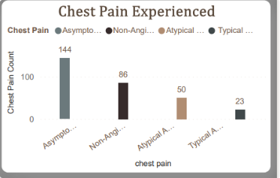
Chest Pain and Heart Disease
The report explores the relationship between different types of chest pain and the presence of heart disease, providing valuable insights for healthcare professionals. By understanding the diagnostic value of various chest pain characteristics, clinicians can make more informed decisions and develop more effective treatment plans.
Chest Pain Type
Heart Disease Prevalence
Typical Angina
High
Atypical Angina
Moderate
Non-Anginal
Low
Chest Pain Characteristics
The report delves into the different types of chest pain experienced by patients, providing valuable insights into the underlying causes and potential implications for diagnosis and treatment. Understanding the nuances of chest pain can help healthcare providers make more accurate assessments and develop personalized care plans.
Typical Angina
Atypical Angina
Non-Anginal
Patients with typical angina experience a distinct, crushing chest pain that is often triggered by physical exertion or emotional stress.
Atypical angina presents with less characteristic chest pain, making it more challenging to diagnose and requiring a more comprehensive evaluation.
Non-anginal chest pain may be caused by a variety of non-cardiac conditions, necessitating a thorough investigation to determine the underlying cause.

Slide 10

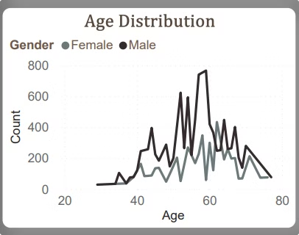


Heart Disease Prevalence Age by Gender
The report examines the overall prevalence of heart disease across genders, providing a comprehensive view of the burden of cardiovascular disease in male and female populations. This information is crucial for healthcare systems to allocate resources, develop targeted prevention strategies, and ensure equitable access to high-quality care.
Male
Heart disease is more common in male patients, underscoring the need for focused efforts to address the unique risk factors and health needs of this population.
Female
While less prevalent, heart disease in female patients can be just as severe and requires specialized attention to improve outcomes.

Slide 11

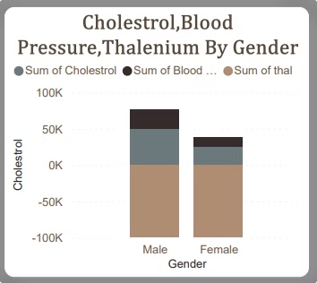



Cholesterol, Blood Pressure, and Thalassemia
The report examines the interplay between cholesterol levels, blood pressure, and the presence of thalassemia, a genetic blood disorder. Understanding these complex relationships is crucial for accurately assessing cardiovascular risk and developing comprehensive treatment strategies that address the unique needs of each patient.
Cholesterol
High cholesterol levels are a well-established risk factor for heart disease, contributing to the development of atherosclerosis and increased cardiovascular events.
Blood Pressure
Elevated blood pressure, or hypertension, is another major risk factor for heart disease, often co-occurring with high cholesterol levels.
Thalassemia
The presence of thalassemia, a genetic blood disorder, can also impact cardiovascular health and interact with other risk factors, requiring careful monitoring and management.

Slide 12

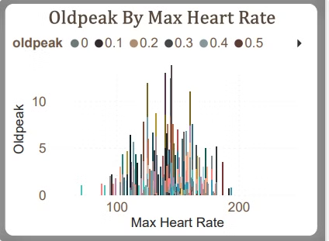
Oldpeak and Max Heart Rate
The report examines the relationship between the "Oldpeak" parameter, which measures the depression of the ST segment during an exercise electrocardiogram, and the maximum heart rate achieved during the test. Understanding the interplay between these two factors can provide valuable insights into the severity of heart disease and guide the development of appropriate treatment strategies.
Oldpeak
The Oldpeak parameter is a crucial indicator of the degree of myocardial ischemia, with higher values suggesting more severe heart disease.
Max Heart Rate
The maximum heart rate achieved during an exercise test is another important marker of cardiovascular fitness and can provide insights into the overall health of the heart.

Slide 13
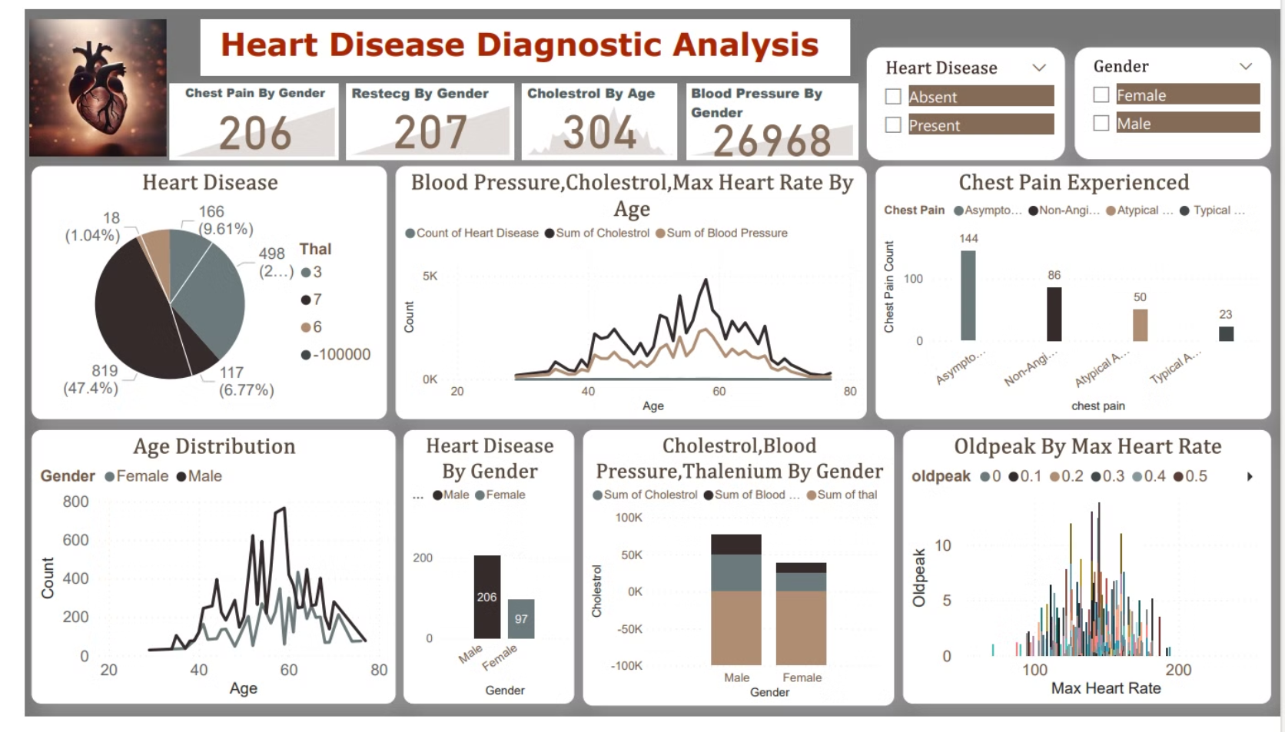

Slide 14
Thank you !

